Slide 1
Computer Fundamentals Course -101 Fall 2016

Slide 2
Hello !
Who am I ?
Md. Mohaimenul Hossain Nahin (MHN)
‘Mohaimen Sir’ would be perfect!
Masters in Pervasive Computing and Communications From (France, Finland, Sweden)
Bachelors in CSE from Islamic University of Technology (IUT)
How to contact me?
Call 01685299561 (Not after 10pm)
Mail : mohaimen.hossain@uap-bd.edu
Facebook

Slide 3
Goal of this Course
Basics of Computer Fundamentals
Number Theory
C programming

Slide 4
Participation
Lets Start by Tell us about yourself!!
Starting from left Corner Answer these questions
Name
School and College
Why CSE?

Slide 5
Marks Diustribution
Attendance : 10 marks
Quiz: 10 marks (2 quizes avg. )
Mid: 20 marks (1 mid)
Final: 60 marks

Slide 6
INTRODUCTION TO
COMPUTER FUNDAMENTALS

Slide 7
What is a COMPUTER?
Computer- General-purpose device that can be programmed to carry out a set of arithmetic or logical operations automatically.
Since a sequence of operations can be readily changed, the computer can solve more than one kind of problem.

Slide 8
Uses of Computers
The progress made in computer saw the expansion of the function of computers. The following are the uses of computers.
Perform Calculations
Storing Information
Communications
Entertainment
Simulations
Artificial Intelligence

Slide 9
What are the different types of computers?
When most people hear the word computer, they think of a personal computer such as a desktop or laptop.
However, computers come in many shapes and sizes, and they perform many different functions in our daily lives.
When you withdraw cash from an ATM, scan groceries at the store, or use a calculator, you're using a type of computer.

Slide 10
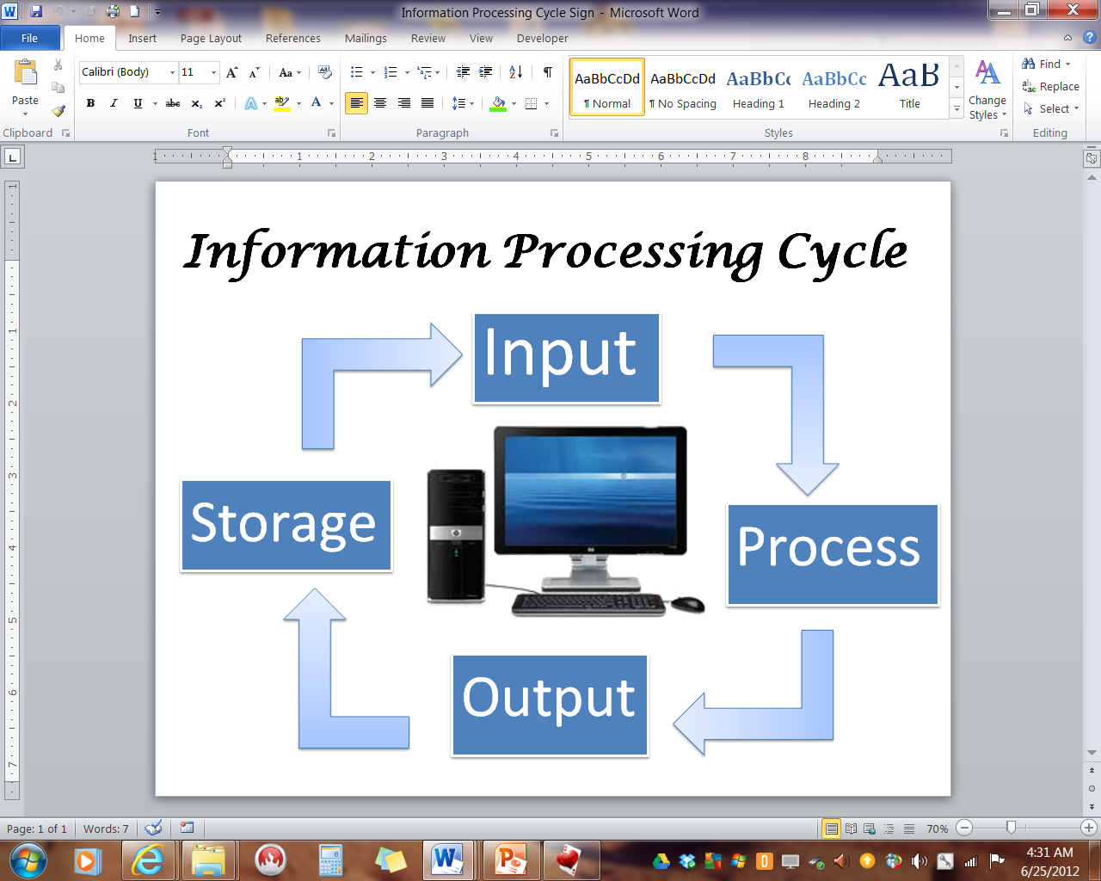
Information Processing Cycle

Slide 11
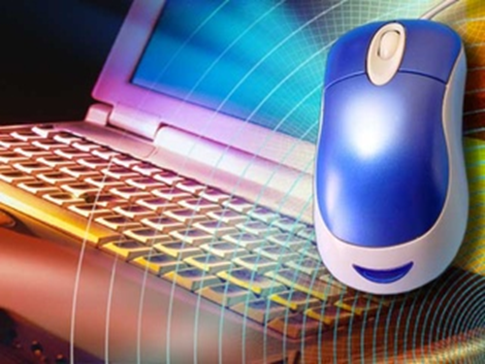
Hardware
The physical, touchable parts of the computer.

Slide 12
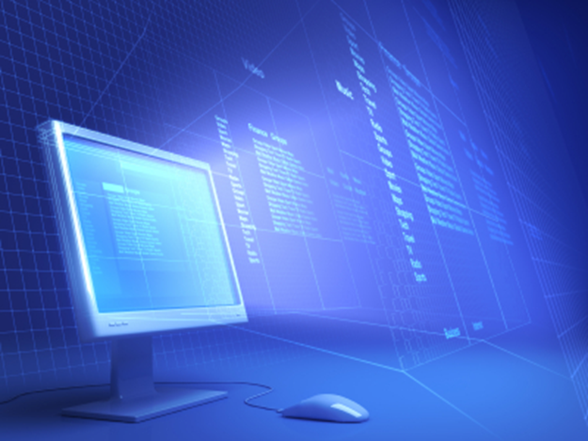
Software
A term that is used in contrast to hardware; everything in the computer that is not hardware is software.
Software allows you to:
Process words
Calculate numbers
Send an e-mail
Browse the Internet
And many more…

Slide 13
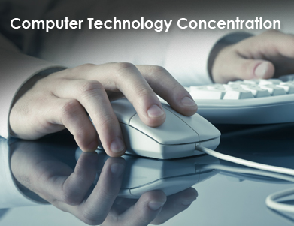
Input
A collection of raw data from the outside world that is put into the computer.
Example: number you put to do calculation

Slide 14
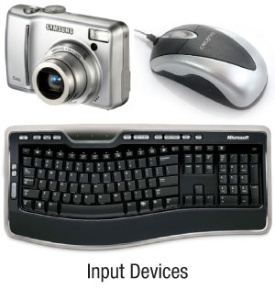
Input Devices
Keyboard
Mouse
Scanner
Digital Camera
Bar code reader
Graphic tablets
And many more…

Slide 15
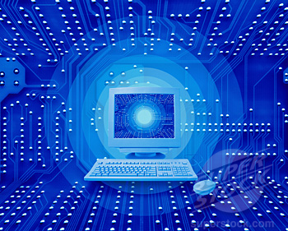
Processing
Manipulating data
Bold, italicize, underline, double space in a word processor
Enter formulas and calculate totals in a spreadsheet
Edit a picture

Slide 16
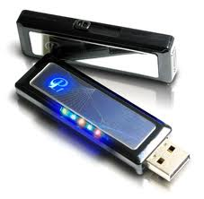
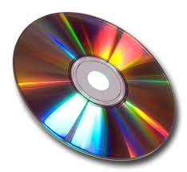
Storage
The place where data is held when it is not needed for processing
Storage Devices are computer components capable of storing digital data
Examples of Storage Devices:
Floppy Disk (obsolete)
Hard Drive
CD, DVD
Flash Drive

Slide 17
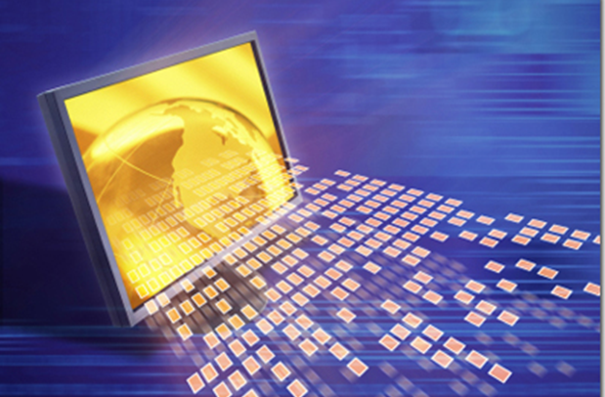
Output
The results of processed data
Examples of output:
A printed paper
A presentation
Audio
Video
Data is entered through various forms (input) into a computer, the data is manipulated (processing), and then information is presented to a human (output).

Slide 18
Output Devices
Monitor
Speakers
Printer
Headphones

Slide 19
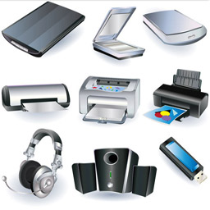
Peripherals
AKA—Peripheral Devices
Any hardware device connected to the computer that expands the computer’s input, output and storage capabilities

Slide 20
What is an operating system?
An operating system is the most important software that runs on a computer.
It manages the computer's memory, processes, and all of its software and hardware.
It also allows you to communicate with the computer without knowing how to speak the computer's language.
Without an operating system, a computer is useless.
Example: Windows, MacOS X, Linux

